Slide 1
PMT monthly call
April 2023

Slide 2
Agenda AGISTIN PMT
Welcome and adoption of the Agenda
Follow up of action points
Coordinator issues (Financial, contractual, operational planning)
Progress with deliverables and milestones
Reporting on events attended and plans for future events
Reports on WP progress (WP leader)
Any other business

Slide 3
Participants
EEU (Coord) (WP1) (WP7) | Gianluca, Eunice
RINA (WP2)
Uni Kassel (WP3)
Fraunhofer (WP4) | Siddhi, Christoph
Shell (WP5) | Martijn
UPC (WP6) | Eduardo
RTE | Thibault
Cartif | Roberto
CIEMAT | Angel
Geyser | Daria
Infrastrcures Cat
EASE | Maria
ETH Zurich

Slide 4
Follow up of action points
AP # | Description | Responsible | Status
1
2
3

Slide 5
Progress with deliverables and milestones
Next Deliverables
D1.2 – Data Management Plan (EEU) (M6 – June 2023)
D7.1 – First DEC Plan (EEU) (M6 – June 2023)
Milestones
MS2: Innovative energy storage integration requirements, incentives and constraints (RTE) (M6 – June 2023)
Excel spreadsheet prepared and discussed with partners
Short explanation video prepared
Fill in the full excel by June

Slide 6



Case 1
P

Slide 7
Battery Model: Constraints
# Variables b.Pdim_FCR = pyo.Var(initialize=0, bounds=(0, 4.8)) # Power capacity of the battery for FCR provision , bounds=(0, 480000) b.Edim_FCR = pyo.Var(initialize=0) # Power capacity of the battery for FCR provision b.P_FCRCharge = pyo.Var( t, initialize={k:0.0 for k in range(len(t))}) # Power demanded according the current frequency b.P_FCRDisCharge = pyo.Var( t, initialize={k:0.0 for k in range(len(t))}, bounds=(-4.80, 0)) # Power demanded according the current frequency b.EnerStorg = pyo.Var(t,initialize={k:0.0 for k in range(len(t))}, within=pyo.NonNegativeReals) b.Pout = pyo.Var(t, initialize={k:0.0 for k in range(len(t))}, within=pyo.Reals)
#def Constraint_Edim_FCR(b): # return b.Edim_FCR <= 4*(b.Pdim_FCR) #b.c_Edim_FCR = pyo.Constraint (rule = Constraint_Edim_FCR)
def Constraint_Pout(b, t,): return b.Pout[t] == (b.P_FCRCharge[t] + b.P_FCRDisCharge[t]) b.c_Pout = pyo.Constraint(t, rule = Constraint_Pout)
def Constraint_P_FCRCharge(b, t): return b.P_FCRCharge[t] <= b.Pdim_FCR b.c_P_FCRCharge = pyo.Constraint(t, rule=Constraint_P_FCRCharge)
def Constraint_P_FCRCharge_1(b, t,): return b.P_FCRCharge[t] <= (50 - (b.Fup[t])) * (b.Pdim_FCR) * b.slope_fcr b.c_P_FCRCharge_1 = pyo.Constraint(t, rule = Constraint_P_FCRCharge_1)
# Parameters b.E0 = pyo.Param(initialize=data['E0']) # Energy storage at the battery at the beggiing of the simulation (_t=0) b.slope_fcr = pyo.Param(initialize=data['slope_fcr']) # statik for the FCR ( 100% power by a 200mH deviation) b.Fup = pyo.Param(t, initialize=data['FCharge']) # Grid frequency > 50 (time serie) b.Fdown = pyo.Param(t, initialize=data['FDisCharge']) # Grid frequency < 50 (time serie)
def Constraint_P_FCRDisCharge(b, t,): return b.P_FCRDisCharge[t] >= (50 - (b.Fdown[t])) * (b.Pdim_FCR) * b.slope_fcr
b.c_P_FCRDisCharge = pyo.Constraint(t, rule = Constraint_P_FCRDisCharge)
def Constraint_EnerStorg(b, t): if t==0: return b.EnerStorg[t] == (b.E0) + (b.P_FCRCharge[t]) + (b.P_FCRDisCharge[t]) else: return b.EnerStorg[t] == b.EnerStorg[t-1] + (b.P_FCRCharge[t]) + (b.P_FCRDisCharge[t]) b.c_EnerStorg= pyo.Constraint(t, rule = Constraint_EnerStorg)
def Constraint_Edim_FCR_1(b, t): return b.EnerStorg[t] <= b.Edim_FCR b.c_Edim_FCR_1 = pyo.Constraint(t, rule = Constraint_Edim_FCR_1)

Slide 8
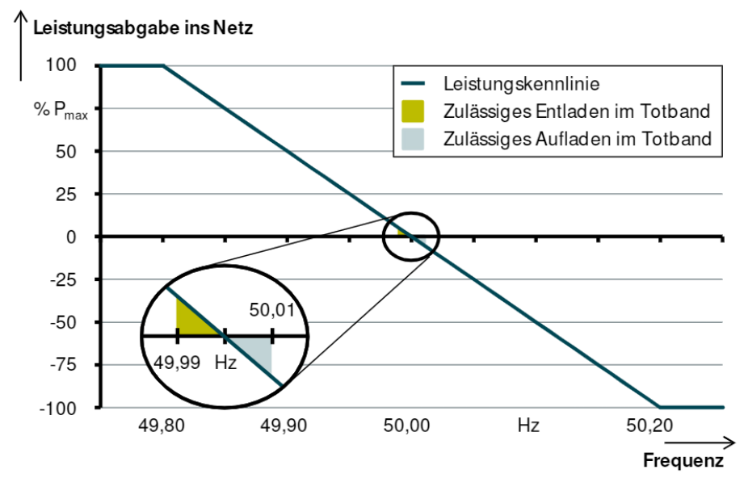
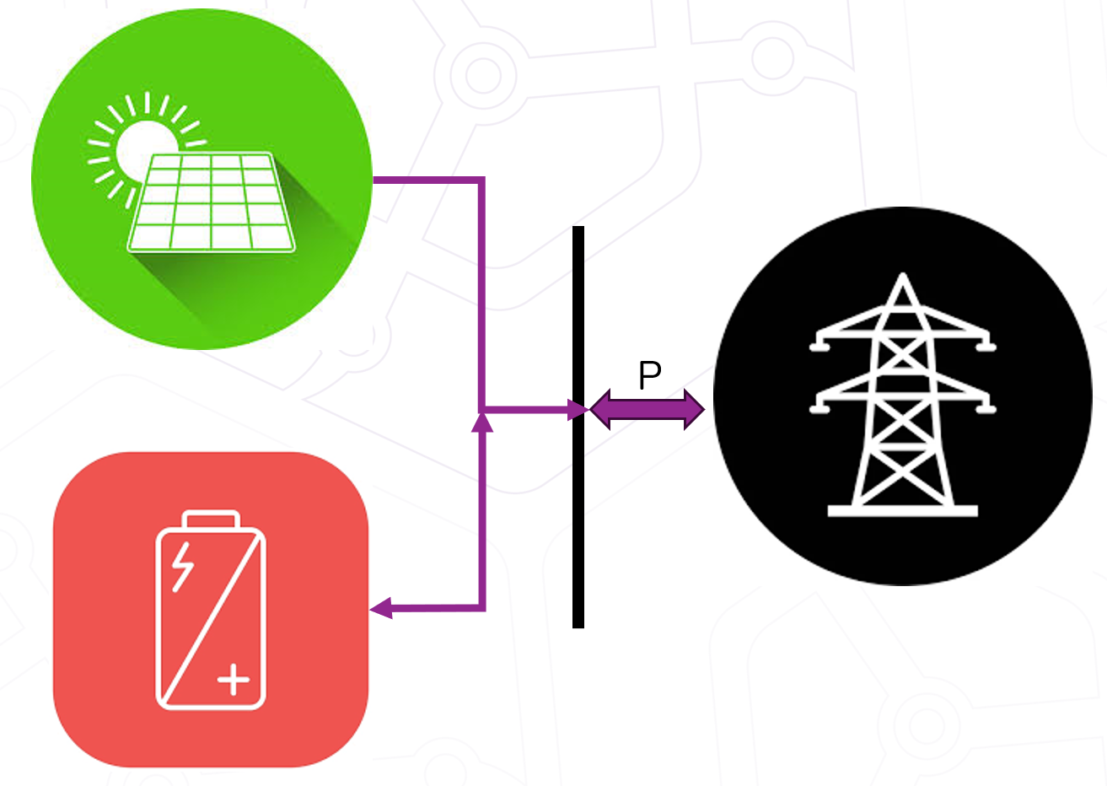
Case 1 - TSO demanded FCR Charging & Discharing profile BESS
Parameters
Rated frequency: 50 Hz
BESS[MW]: 4.8 M
Frequency: f[t]
FCR Gradient: ∆_FCR
P_FCR[t]: (50 - f[t])* BESS[MW]* ∆_FCR

Slide 9
Case 1 - Results
Max_BESS (MW)= 4.8
Initial SCO: 4 MWh
PV_Init_Installed: 2.4 M
The P_FCR_Supplied is not mathing the demand, since the total energy demanded for dischargin is lowe than the energy storaged because of charging, plus the initial SOC. Because of that, the solver adjust the values so that the requierment of the last time steps ar fullfiled.

Slide 10
Case 1 - Results
EXIT: Optimal Solution Found.
Pdim_FCR : Size=1, Index=None
Key : Lower : Value : Upper : Fixed : Stale : Domain
None : 0 : 4.8 : 4.8 : False : False : Reals
Pdim : Size=1, Index=None
Key : Lower : Value : Upper : Fixed : Stale : Domain
None : 0 : 1.7760000222586665 : 100000 : False : False : NonNegativeReals
Edim_FCR : Size=1, Index=None
Key : Lower : Value : Upper : Fixed : Stale : Domain
None : None : 7.816000029087755 : None : False : False : Reals
PV_add_Int: 1.77 MW
BESS_MWh_Required: 7.816 MWh
BESS_MWh_Required: 4.8 Mwh
In oder to maximize the objective function the solver try reach the maximun possible BESS powe capacity
Whe FCR ask for charging, the PV power goes to the BESS, the remaining power goes to the grid

Slide 11
Case 1: Assumptions
PV-Forecast
Costs
Objective function
cost_new_battery_MW = 55 # Euros/day cost_new_battery_MWh = 82 # Euros/day cost_new_pv = 1.1 # Euros/day
def obj_fun(m): return ((sum(((m.Battery.P_FCRCharge[t]*22) + (m.Battery.P_FCRDisCharge[t])*-44 for t in l_t)) ) - (cost_new_battery_MW*m.Battery.Pdim_FCR) - (cost_new_battery_MWh*m.Battery.Edim_FCR)) - (cost_new_pv*m.PV.Pdim) m.goal = pyo.Objective(rule=obj_fun, sense=pyo.maximize)

Slide 12
Case 1.1

Slide 13
Case 1.2

Slide 14
Reporting on events attended
EPRI European Workshop, March 14-16 Vienna
AGISTIN rollup
BRIDGE General Assembly, March 28-30 Brussels
Gianluca joined representing AGISTIN
Poster session organized by BRIDGE
Upcoming activities in BRIDGE WGs will be communicated soon

Slide 15
Plans for future events
Hydropower projects cluster event, June 14 Brussels
Project officer invited AGISTIN to join
UPC willing to join
Check if communication material
EUSEW
Session not approved
ENLIT 2023, End of November Paris
Joint event or session with HE IPLUG could be organized
HE H2GLASS cooperation
UPC and ETH workshop/course in Barcelona (time TBD)

Slide 16
WP2: Identification and enabling innovative business models for energy storage integration with grid users
Status
Services list prepared by RTE and discussed with partners
Explanation video in preparation
Next steps
To prepare the questionnaire and have stakeholders fill it in

Slide 17
WP3: Enhanced AGI Design for inclusion of innovative forms of storage
Status
Next steps

Slide 18
WP4: Performance assessment for AGI-integrated innovative storage for industrial processes
Status
Meetings with Geyser for battery requirements and delivery schedule
Discussions for FHG lab test setup planning
Use cases definition (Peak Shaving main one)
Next steps
Setting up lab

Slide 19
WP5: Demonstration of AGI-integrated innovative storage for green H2 production
Starts in M8 (August 2023)
Emmen site design ongoing
Involvement of municipality and Emmen community
Finalizing permits (2 months)
Finalizing FEED

Slide 20
WP6: Demonstration of AGI-integrated innovative storage for large pumping loads
Status
Task 4.6 related to WP6. Preparation of sizing tools
Development of optimization software, modular approach
Initial results being gathered and optimization validation
Discussion with ICAT for installation
Possible contacts with other Irrigation canals (Additional validation of tools)
Next steps
Continue sizing tool development/validation
Coordinate with EPRI
Deploy sensors in preparation of field trial

Slide 21
WP7: Dissemination, Communication and Exploitation
Status
Next steps

Slide 22
Coordination issues
Deliverables review process
INGETEAM replacement
Monthly PMT
Next Project meetings

Slide 23
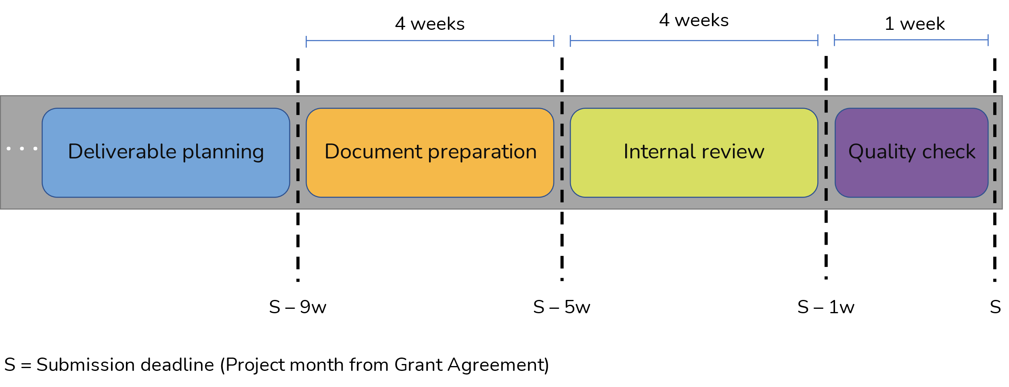
Deliverables review process
For ensuring the proper level of quality for the deliverables of the project, the process foresees the following steps for the creation, writing and revision of project's deliverables:
Deliverable planning
Document preparation
Document review
Quality check
A table with assigned reviewers has been prepared and stored in Sharepoint

Slide 24
INGETEAM replacement
A call with TeknoCEA was organized already. Discussion and feedback was positive
EATON is not responsive enough
Last chance to schedule call by Friday
Set date for General Assembly mid May in any case

Slide 25
Monthly PMT
Set a recurring appointment
Last Wednesday of each month, 10:00-11:30 CET? 15:00-16:30 CET?
Send email to WP1 to confirm
Send appointment for 2023

Slide 26
Next project meetings
September-October 2023 in person
Location TBD (Partners to volunteer if possible)
Project meeting and General Assembly
Could include Advisory Board
February-March 2024 online
Project meeting and review planning
Could include Advisory Board
June-July 2024 in person
Project review with the commission in Brussels

Slide 27
AOB
Advisory Board members to be contacted
Once September meeting location and date confirmed we could eventually organize for AB meeting

